Slide 1

SubToGames.com A Gaming website
By Samandeep Singh And ijaz mirza

Slide 2
How it started? Problems in Gaming Websites
Games are expensive
Individual developers cannot publish their games
There are very few websites that let you play a game on pc with a subscription service
You need to have accounts on different game publishing websites in order to stay connected to your in game friends

Slide 3

Target Audience
Our potential users would be both professional or non professional gamers who love to try new games.
People who just want to try some games before they choose the categories they like
The age group of our users would be from 13 to 35 years

Slide 4
User Survey
Conducting surveys helped us determine what our users really want from our website
We had 51 people who actively participated in our survey
A list of features was provided
Both open and closed ended questions were used to gather responses from our users

Slide 5
User Survey Results
Top Ranked Features:
Achievement Points
Subscription service
Features adopted from user survey:
Game tournaments
Game mods

Slide 6
Features our website offers
A subscription service for pc games
An achievement point system
Gaming tournaments
Gaming mods
Chat service

Slide 7
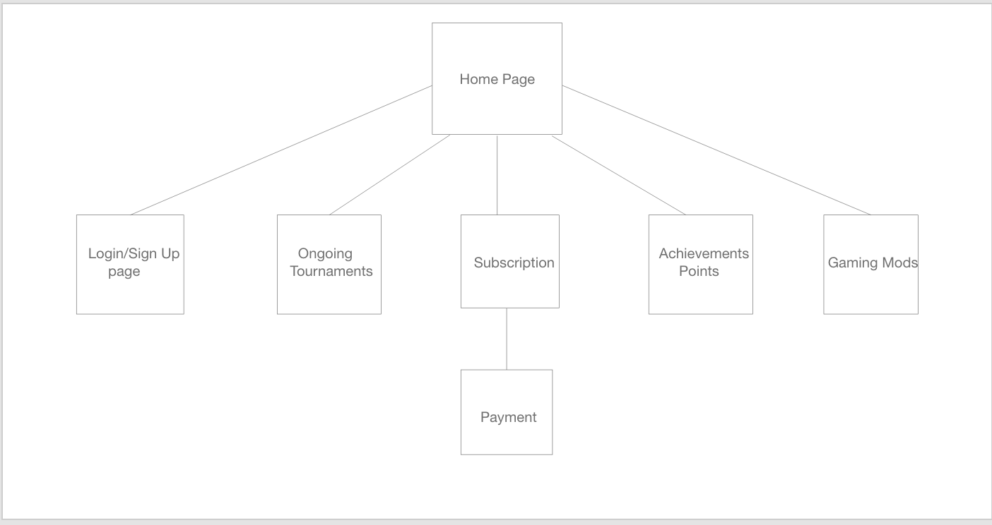
Website Initial wireframes
Site Map

Slide 8

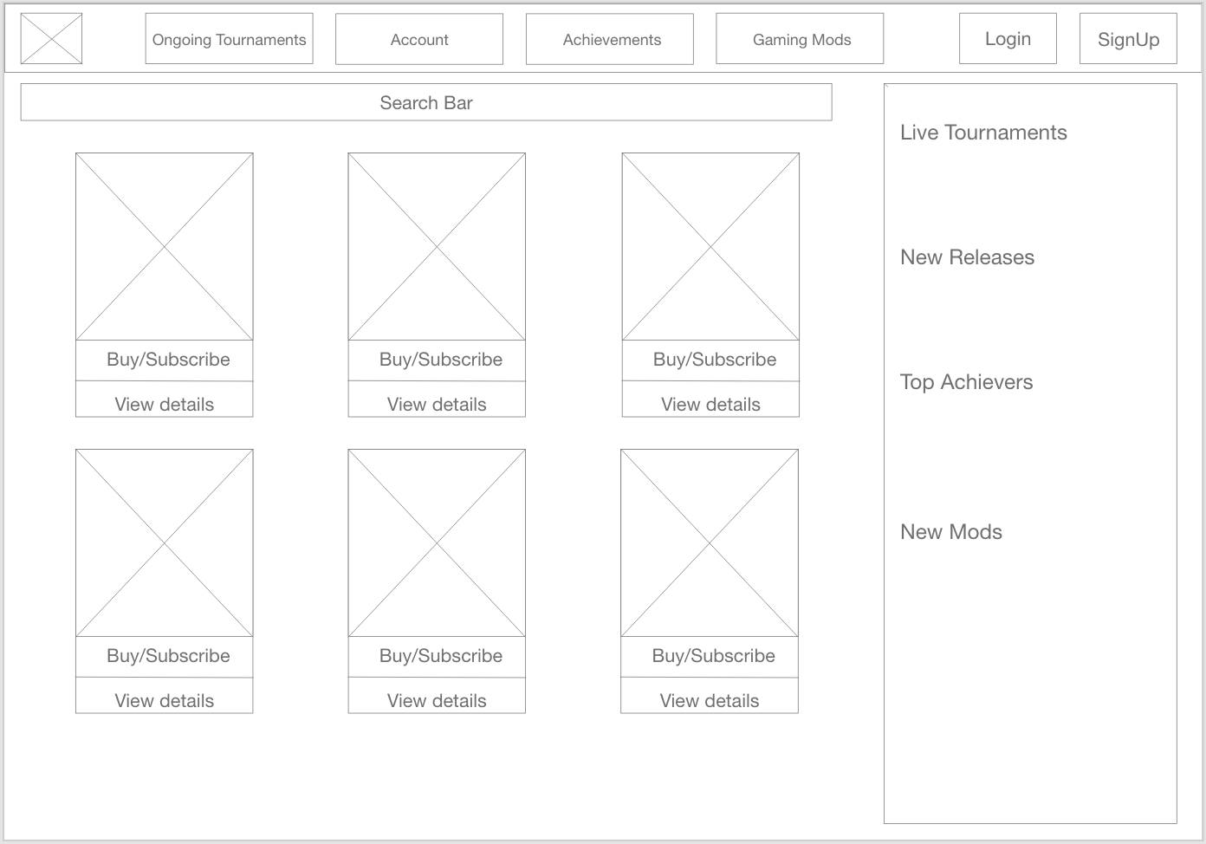



Website Initial wireframes
Home Page

Slide 9
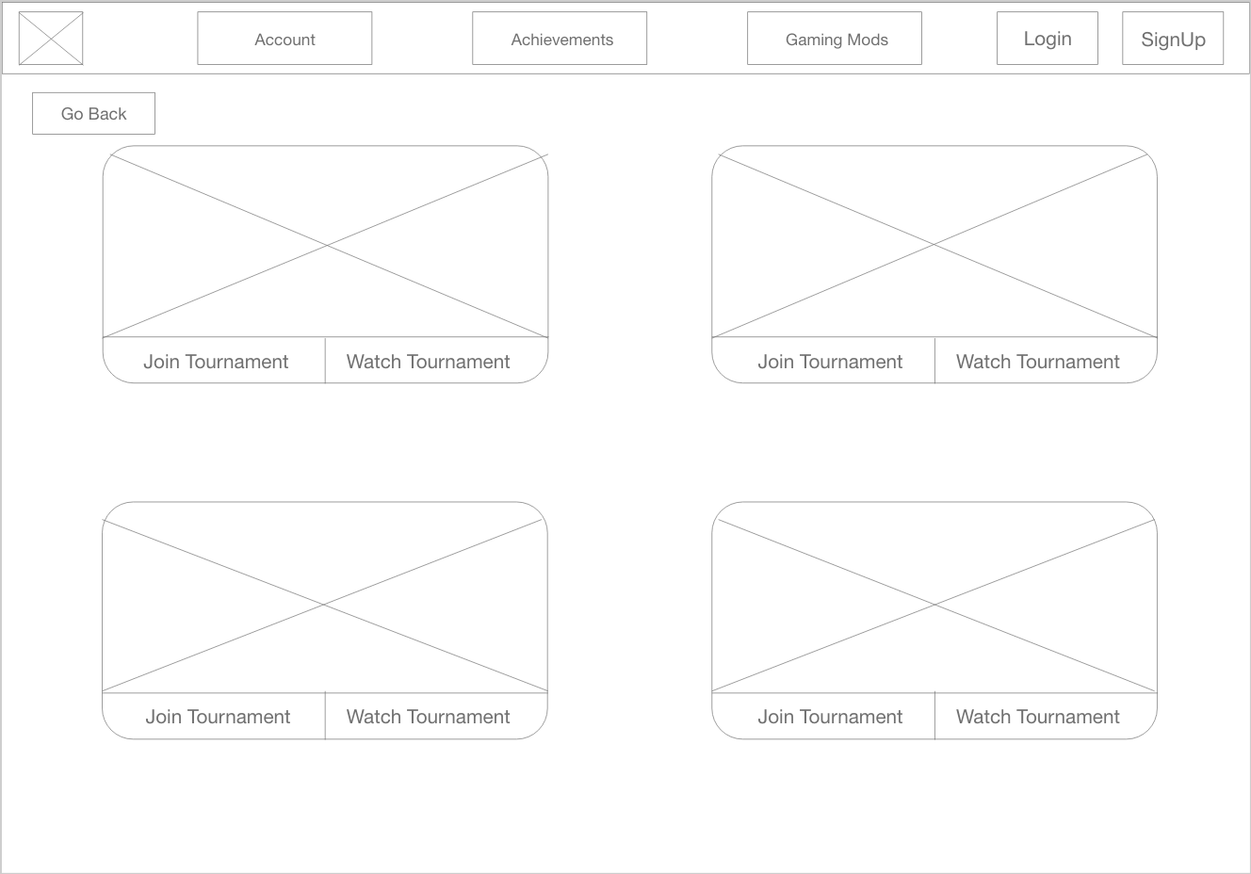
Website Initial wireframes
Ongoing Tournament

Slide 10
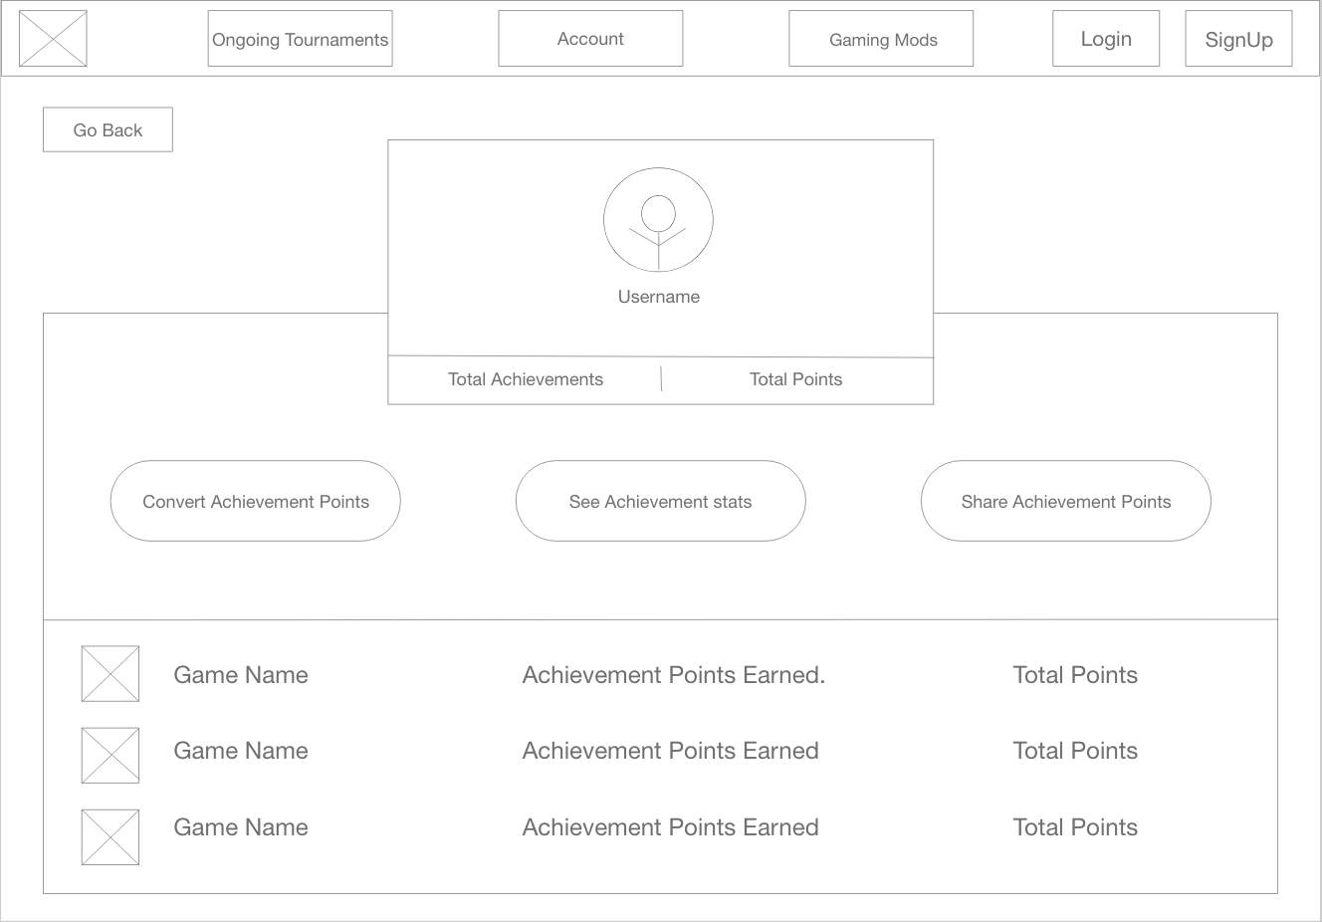
Website Initial wireframes
Achievement Points

Slide 11
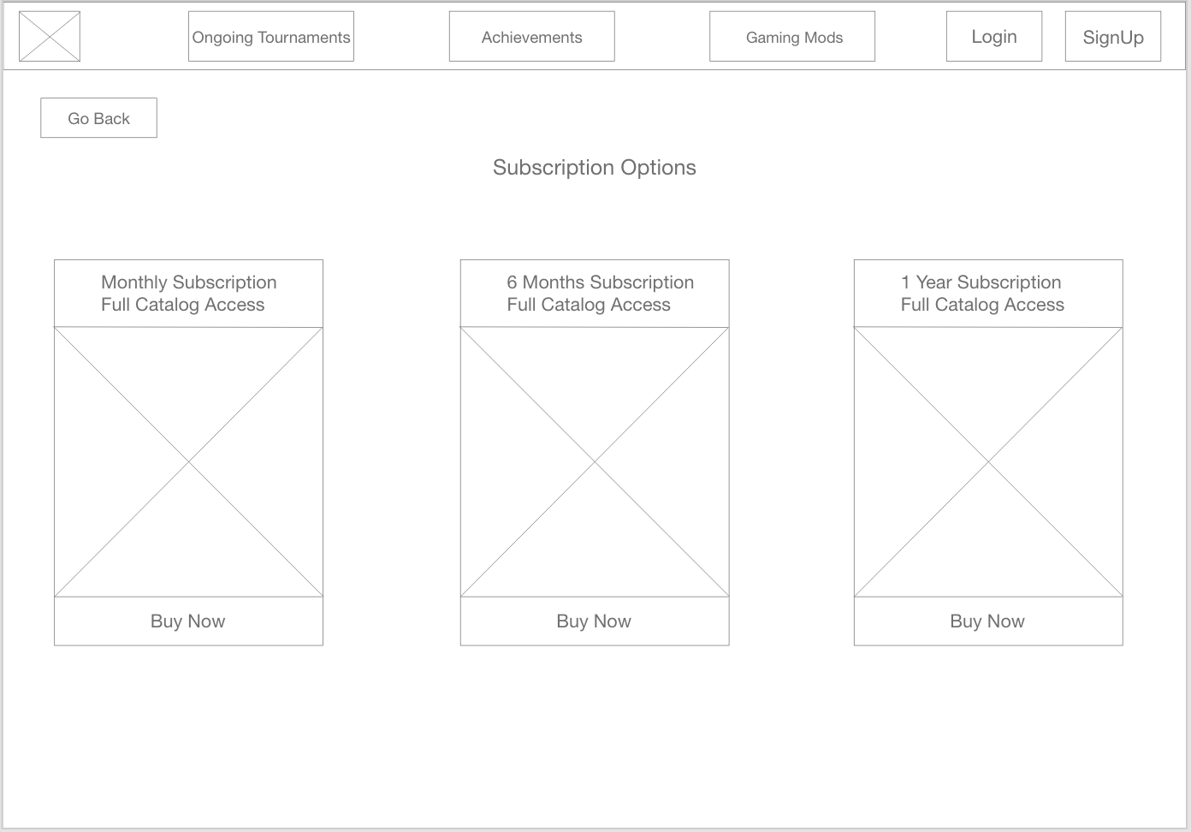
Website Initial wireframes
Subscription Page

Slide 12
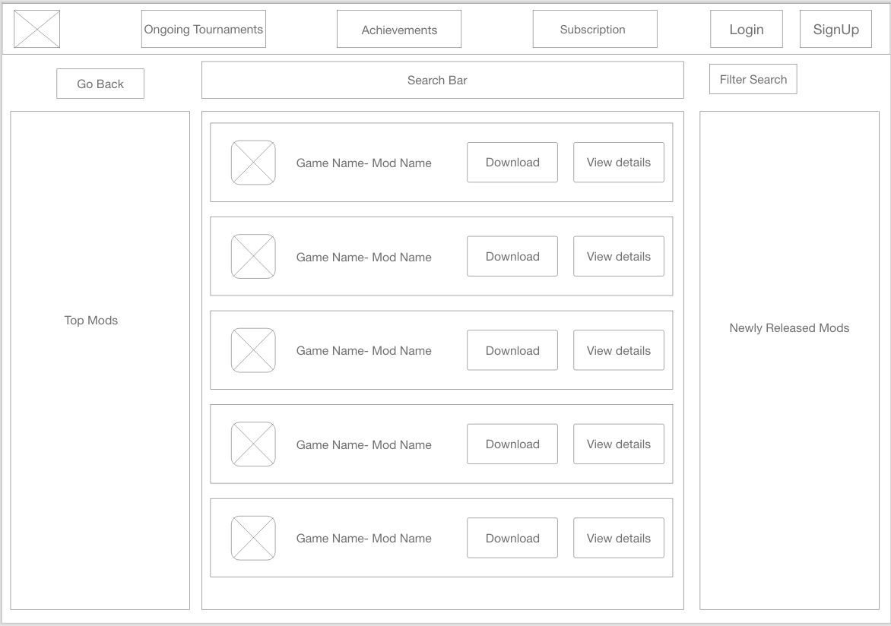
Website Initial Wireframes
Game Mods

Slide 13
User Testing
What went well? (Positive Feedback)
The placement of buttons
Navigation system
Labels of buttons
What didn’t go well? (Negative Feedback)
Achievement page was confusing
Buy/Subscribe button on the home page
Need for a help page

Slide 14
Revised wireframes
Added an order page
Added a help page
Changed Buy/ Subscribe button
Included a cart and home button

Slide 15
Key Points learned
Analyze your audience or users.
Conducting surveys can help avoid mistakes
Create wireframes
User testing is crucial for a web application’s success

Slide 16

Questions?
Thank You

